Slide 1
Assembly Language for Intel-Based Computers
Kip R. Irvine
Chapter 6: Conditional Processing

Slide 2
Boolean and Comparison Instructions
CPU Status Flags
AND Instruction
OR Instruction
XOR Instruction
NOT Instruction
Applications
TEST Instruction
CMP Instruction
Irvine, Kip R. Assembly Language for Intel-Based Computers 5/e, 2007.

Slide 3


AND Instruction
Performs a Boolean AND operation between each pair of matching bits in two operands
Syntax:
    AND destination, source
  (same operand types as MOV)
AND
Irvine, Kip R. Assembly Language for Intel-Based Computers 5/e, 2007.

Slide 4


OR Instruction
Performs a Boolean OR operation between each pair of matching bits in two operands
Syntax:
    OR destination, source
OR
Irvine, Kip R. Assembly Language for Intel-Based Computers 5/e, 2007.

Slide 5

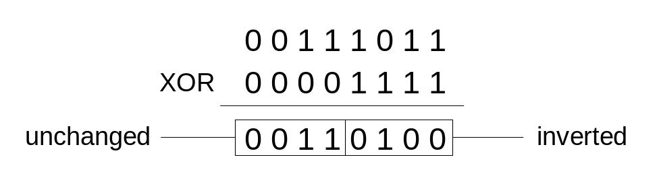
XOR Instruction
Performs a Boolean exclusive-OR operation between each pair of matching bits in two operands
Syntax:
    XOR destination, source
XOR
XOR is a useful way to toggle (invert) the bits in an operand.
Irvine, Kip R. Assembly Language for Intel-Based Computers 5/e, 2007.

Slide 6

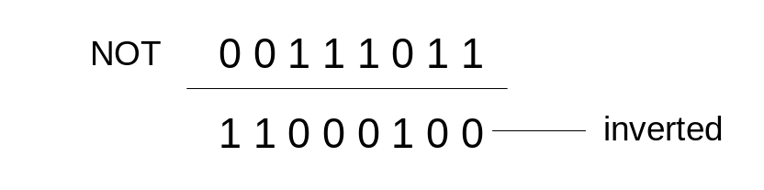
NOT Instruction
Performs a Boolean NOT operation on a single destination operand
Syntax:
    NOT destination
NOT
Irvine, Kip R. Assembly Language for Intel-Based Computers 5/e, 2007.

Slide 7
Applications
Task: Convert the character in AL to upper case.
Solution: Use the AND instruction to clear bit 5.
mov al,'a' ; AL = 01100001b
and al,11011111b ; AL = 01000001b
Irvine, Kip R. Assembly Language for Intel-Based Computers 5/e, 2007.

Slide 8
Applications
Task: Convert a binary decimal byte into its equivalent ASCII decimal digit.
Solution: Use the OR instruction to set bits 4 and 5.
mov al,6 ; AL = 00000110b
or al,00110000b ; AL = 00110110b
The ASCII digit '6' = 00110110b
Irvine, Kip R. Assembly Language for Intel-Based Computers 5/e, 2007.

Slide 9
Applications
Task: Jump to a label if an integer is even.
Solution: AND the lowest bit with a 1. If the result is Zero, the number was even.
mov ax,wordVal
and ax,1 ; low bit set?
jz EvenValue ; jump if Zero flag set
JZ (jump if Zero) is covered in Section 6.3.
Your turn: Write code that jumps to a label if an integer is negative.
Irvine, Kip R. Assembly Language for Intel-Based Computers 5/e, 2007.

Slide 10
Applications
Task: Jump to a label if the value in AL is not zero.
Solution: OR the byte with itself, then use the JNZ (jump if not zero) instruction.
or al,al
jnz IsNotZero ; jump if not zero
ORing any number with itself does not change its value.
Irvine, Kip R. Assembly Language for Intel-Based Computers 5/e, 2007.

Slide 11
TEST Instruction
Performs a nondestructive AND operation between each pair of matching bits in two operands
No operands are modified, but the Zero flag is affected.
Example: jump to a label if either bit 0 or bit 1 in AL is set.
test al,00000011b
jnz ValueFound
Example: jump to a label if neither bit 0 nor bit 1 in AL is set.
test al,00000011b
jz ValueNotFound
Irvine, Kip R. Assembly Language for Intel-Based Computers 5/e, 2007.

Slide 12
CMP Instruction (1 of 3)
Compares the destination operand to the source operand
Syntax: CMP destination, source
Example: destination == source
mov al,5
cmp al,5 ; Zero flag set
Example: destination < source
mov al,4
cmp al,5 ; Carry flag set
Irvine, Kip R. Assembly Language for Intel-Based Computers 5/e, 2007.

Slide 13
CMP Instruction (2 of 3)
Example: destination > source
mov al,6
cmp al,5 ; ZF = 0, CF = 0
(both the Zero and Carry flags are clear)
Irvine, Kip R. Assembly Language for Intel-Based Computers 5/e, 2007.

Slide 14
CMP Instruction (3 of 3)
The comparisons shown here are performed with signed integers.
Example: destination > source
mov al,5
cmp al,-2 ; Sign flag == Overflow flag
Example: destination < source
mov al,-1
cmp al,5 ; Sign flag != Overflow flag
Irvine, Kip R. Assembly Language for Intel-Based Computers 5/e, 2007.

Slide 15
Conditional Jumps
Jumps Based On . . .
  Specific flags
  Equality
  Unsigned comparisons
  Signed Comparisons
Applications
Bit Test (BT) Instruction
Irvine, Kip R. Assembly Language for Intel-Based Computers 5/e, 2007.

Slide 16
Jcond Instruction
A conditional jump instruction branches to a label when specific register or flag conditions are met
Examples:
  JC jump to a label if the Carry flag is set
  JE, JZ jump to a label if the Zero flag is set
  JS jumps to a label if the Sign flag is set
  JNE, JNZ jump to a label if the Zero flag is clear
  JECXZ jumps to a label if ECX equals 0
Irvine, Kip R. Assembly Language for Intel-Based Computers 5/e, 2007.

Slide 17
Jcond Ranges
Prior to the 386:
  jump must be within –128 to +127 bytes from current location counter
IA-32 processors:
  32-bit offset permits jump anywhere in memory
Irvine, Kip R. Assembly Language for Intel-Based Computers 5/e, 2007.

Slide 18
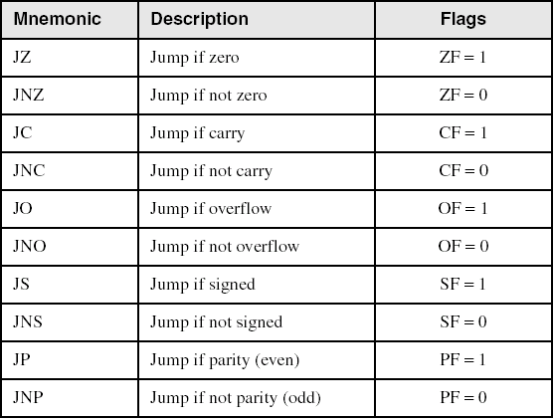
Jumps Based on Specific Flags
Irvine, Kip R. Assembly Language for Intel-Based Computers 5/e, 2007.

Slide 19
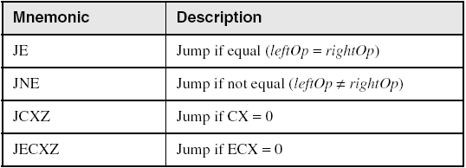
Jumps Based on Equality
Irvine, Kip R. Assembly Language for Intel-Based Computers 5/e, 2007.

Slide 20
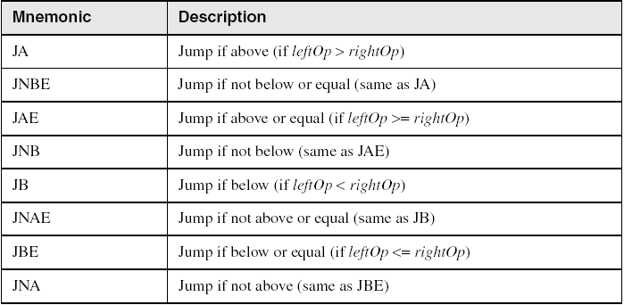
Jumps Based on Unsigned Comparisons
Irvine, Kip R. Assembly Language for Intel-Based Computers 5/e, 2007.

Slide 21
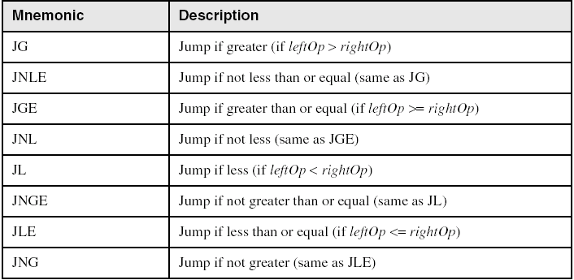
Jumps Based on Signed Comparisons
Irvine, Kip R. Assembly Language for Intel-Based Computers 5/e, 2007.

Slide 22
Applications (1 of 5)
Task: Jump to a label if unsigned EAX is greater than EBX
Solution: Use CMP, followed by JA
cmp eax,ebx
ja Larger
Task: Jump to a label if signed EAX is greater than EBX
Solution: Use CMP, followed by JG
cmp eax,ebx
jg Greater
Irvine, Kip R. Assembly Language for Intel-Based Computers 5/e, 2007.

Slide 23
Applications (2 of 5)
Jump to label L1 if unsigned EAX is less than or equal to Val1
cmp eax,Val1
jbe L1 ; below or equal
Jump to label L1 if signed EAX is less than or equal to Val1
cmp eax,Val1
jle L1
Irvine, Kip R. Assembly Language for Intel-Based Computers 5/e, 2007.

Slide 24
Applications (3 of 5)
Compare unsigned AX to BX, and copy the larger of the two into a variable named Large
  mov Large,bx
  cmp ax,bx
  jna Next
  mov Large,ax
Next:
Compare signed AX to BX, and copy the smaller of the two into a variable named Small
  mov Small,ax
  cmp bx,ax
  jnl Next
  mov Small,bx
Next:
Irvine, Kip R. Assembly Language for Intel-Based Computers 5/e, 2007.

Slide 25
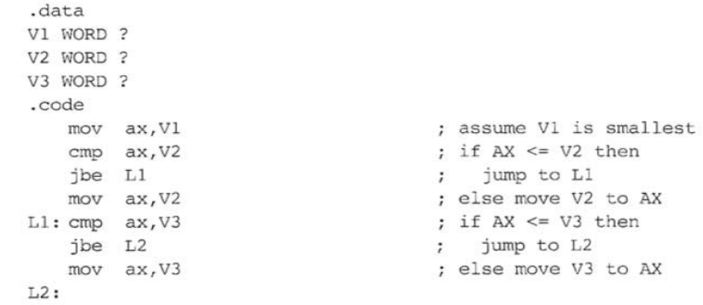
Applications (4 of 5)
Move to AX the smallest of three locations.
Jump to label L2 if the doubleword in memory pointed to by DI is even
test DWORD PTR [di],1
jz L2
Irvine, Kip R. Assembly Language for Intel-Based Computers 5/e, 2007.

Slide 26
Applications (5 of 5)
Task: Jump to label L1 if bits 0, 1, and 3 in AL are all set.
Solution: Clear all bits except bits 0, 1,and 3. Then compare the result with 00001011 binary.
and al,00001011b ; clear unwanted bits
cmp al,00001011b ; check remaining bits
je L1 ; all set? jump to L1
Irvine, Kip R. Assembly Language for Intel-Based Computers 5/e, 2007.

Slide 27
Your turn . . .
Write code that jumps to label L1 if either bit 4, 5, or 6 is set in the BL register.
Write code that jumps to label L1 if bits 4, 5, and 6 are all set in the BL register.
Write code that jumps to label L2 if AL has even parity.
Write code that jumps to label L3 if EAX is negative.
Write code that jumps to label L4 if the expression (EBX – ECX) is greater than zero.
Irvine, Kip R. Assembly Language for Intel-Based Computers 5/e, 2007.

Slide 28
BT (Bit Test) Instruction
Copies bit n from an operand into the Carry flag
Syntax: BT bitBase, n
  bitBase may be r/m16 or r/m32
  n may be r16, r32, or imm8
Example: jump to label L1 if bit 9 is set in the AX register:
bt AX,9 ; CF = bit 9
jc L1 ; jump if Carry
BTC, BTR, and BTS
Irvine, Kip R. Assembly Language for Intel-Based Computers 5/e, 2007.

Slide 29
BT (Bit Test) Instruction
The following code finds the first non-negative value in an array:
.data
arr dw -2,-4,-77,5566h,7788h
val dw ?
.code
  mov bx,0
  mov cx, 5
  LL:
  mov ax , [arr+bx]
  bt ax,15
  jnc found
  add bx,2
  loop LL
  jmp fin
  found:
  mov val,bx
  fin:
  mov ah,4ch
  int 21h
Irvine, Kip R. Assembly Language for Intel-Based Computers 5/e, 2007.

Slide 30
Conditional Structures
Block-Structured IF Statements
Compound Expressions with AND
Compound Expressions with OR
WHILE Loops
Irvine, Kip R. Assembly Language for Intel-Based Computers 5/e, 2007.

Slide 31
Block-Structured IF Statements
Assembly language programmers can easily translate logical statements written in C++/Java into assembly language. For example:
if( op1 == op2 )
X = 1;
else
X = 2;
  mov eax,op1
  cmp eax,op2
  jne L1
  mov X,1
  jmp L2
L1: mov X,2
L2:
Irvine, Kip R. Assembly Language for Intel-Based Computers 5/e, 2007.

Slide 32
Your turn . . .
Implement the following pseudocode in assembly language. All values are unsigned:
if( ebx <= ecx )
{
eax = 5;
edx = 6;
}
  cmp ebx,ecx
  ja next
  mov eax,5
  mov edx,6
next:
(There are multiple correct solutions to this problem.)
Irvine, Kip R. Assembly Language for Intel-Based Computers 5/e, 2007.

Slide 33
Your turn . . .
Implement the following pseudocode in assembly language. All values are 32-bit signed integers:
if( var1 <= var2 )
var3 = 10;
else
{
var3 = 6;
var4 = 7;
}
  mov eax,var1
  cmp eax,var2
  jle L1
  mov var3,6
  mov var4,7
  jmp L2
L1: mov var3,10
L2:
(There are multiple correct solutions to this problem.)
Irvine, Kip R. Assembly Language for Intel-Based Computers 5/e, 2007.

Slide 34
Compound Expression with AND (1 of 3)
short-circuit evaluation
In the following example, if the first expression is false, the second expression is skipped:
if (al > bl) AND (bl > cl)
X = 1;
Irvine, Kip R. Assembly Language for Intel-Based Computers 5/e, 2007.

Slide 35
Compound Expression with AND (2 of 3)
if (al > bl) AND (bl > cl)
X = 1;
This is one possible implementation . . .
cmp al,bl ; first expression...
ja L1
jmp next
L1:
cmp bl,cl ; second expression...
ja L2
jmp next
L2: ; both are true
mov X,1 ; set X to 1
next:
Irvine, Kip R. Assembly Language for Intel-Based Computers 5/e, 2007.

Slide 36
Compound Expression with AND (3 of 3)
if (al > bl) AND (bl > cl)
X = 1;
But the following implementation uses 29% less code by reversing the first relational operator. We allow the program to "fall through" to the second expression:
cmp al,bl ; first expression...
jbe next ; quit if false
cmp bl,cl ; second expression...
jbe next ; quit if false
mov X,1 ; both are true
next:
Irvine, Kip R. Assembly Language for Intel-Based Computers 5/e, 2007.

Slide 37
Your turn . . .
Implement the following pseudocode in assembly language. All values are unsigned:
if( ebx <= ecx
&& ecx > edx )
{
eax = 5;
edx = 6;
}
  cmp ebx,ecx
  ja next
  cmp ecx,edx
  jbe next
  mov eax,5
  mov edx,6
next:
(There are multiple correct solutions to this problem.)
Irvine, Kip R. Assembly Language for Intel-Based Computers 5/e, 2007.

Slide 38
Compound Expression with OR (1 of 2)
short-circuit evaluation
In the following example, if the first expression is true, the second expression is skipped:
if (al > bl) OR (bl > cl)
X = 1;
Irvine, Kip R. Assembly Language for Intel-Based Computers 5/e, 2007.

Slide 39
Compound Expression with OR (1 of 2)
if (al > bl) OR (bl > cl)
X = 1;
We can use "fall-through" logic to keep the code as short as possible:
cmp al,bl ; is AL > BL?
ja L1 ; yes
cmp bl,cl ; no: is BL > CL?
jbe next ; no: skip next statement
L1: mov X,1 ; set X to 1
next:
Irvine, Kip R. Assembly Language for Intel-Based Computers 5/e, 2007.

Slide 40
WHILE Loops
A WHILE loop is really an IF statement followed by the body of the loop, followed by an unconditional jump to the top of the loop. Consider the following example:
while( eax < ebx)
eax = eax + 1;
This is a possible implementation:
top: cmp eax,ebx ; check loop condition
jae next ; false? exit loop
inc eax ; body of loop
jmp top ; repeat the loop
next:
Irvine, Kip R. Assembly Language for Intel-Based Computers 5/e, 2007.

Slide 41
Your turn . . .
Implement the following loop, using unsigned 32-bit integers:
while( ebx <= val1)
{
ebx = ebx + 5;
val1 = val1 - 1
}
top: cmp ebx,val1 ; check loop condition
ja next ; false? exit loop
add ebx,5 ; body of loop
dec val1
jmp top ; repeat the loop
next:
Irvine, Kip R. Assembly Language for Intel-Based Computers 5/e, 2007.

Slide 42
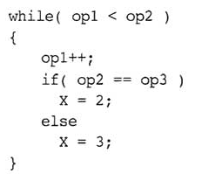
IF statement Nested in a Loop
Implement the following loop, using unsigned 32-bit integers:
Irvine, Kip R. Assembly Language for Intel-Based Computers 5/e, 2007.

Slide 43
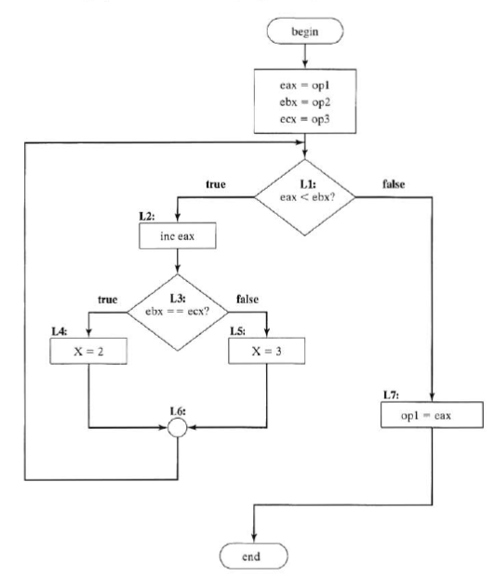
Irvine, Kip R. Assembly Language for Intel-Based Computers 5/e, 2007.

Slide 44
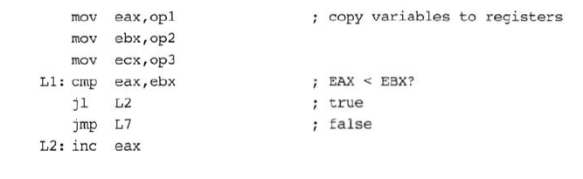
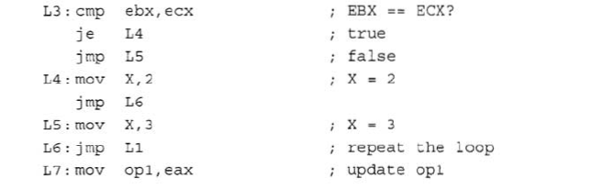
IF statement Nested in a Loop
Irvine, Kip R. Assembly Language for Intel-Based Computers 5/e, 2007.

